Slide 1
A SIMULATION ON TRAFFIC-SIGNAL CONTROL
STUDENT: XIANGYU KONG DATE: 11/27/2017
PEIYUAN SUN
MINGYI LIU

Slide 2
OUTLINE
Introduction To the Main Goal
Simulation Approach
Simulation Process
Simulation Result
Result Analysis

Slide 3
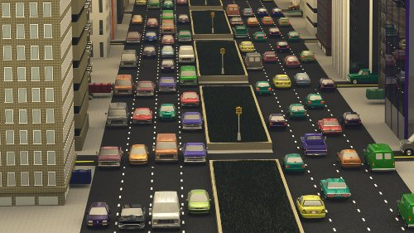
Introduction To the Main Goal
Basic Idea
Cellular Automaton
Main Goal
Simulate the one direction traffic

Slide 4
Introduction To the Main Goal
Basic idea- The Cellular Automaton
discrete model consists of a regular grid of cells,
finite number of states
in our project, the states can be a car’s position, velocity, speed up, etc.
new generation is created according to some fixed rule
rule for updating the state of cells
same for each cell
apply to the whole grid

Slide 5
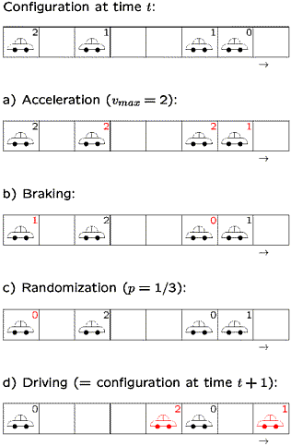
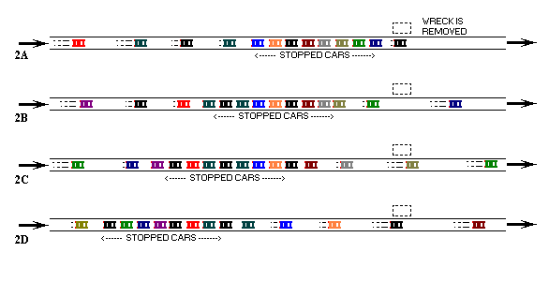
Introduction To the Main Goal
Basic idea- The Cellular Automaton
the application in traffic:
position and velocity are determined by the car’s previous state and that of the front car

Slide 6
Introduction To the Main Goal
To simulate the traffic condition in a specific way (one direction)：
the main focus of our project lies on whether the traffic will jam or not under different circumstances, like
heavy inflow of traffic
speed limits on road
the ratio of different types of cars having different velocity
especially the duration of the traffic light time

Slide 7
Simulation Approach and Task Division
Main Approach:
Simulate the traffic behavior using C code, and visualize the output by plotting dynamic graph in Matlab to directly help decide the value of parameters for avoiding the traffic jam.
cellular automata(referred as CA model) as the prototype for conceptual model.
our grid cell size would be 100*6(road length * number of lanes),
square shaped,
one single car in each cell.

Slide 8
Simulation Process- Part 2 Car Generator
a. We use the a×b matrix to represent the car stream, where a is the number of lanes and b is the length of road. Value 1 means there is a car in that position.
b.Car is generated randomly. To be specific, we use the U distribution to generate random value from 0 to 1, then use value 0.5 to be the decision boundary, i.e, if u > 0.5, CarStream[i][0]=1, else, CarStream[i][0]=0.
c.Write the output car stream to an output file (.txt).
When we input 3 lanes and the length of the road is 10, the “output.txt” is as following:

Slide 9
Simulation Process- Part 2 Car Behavior
Cellular Automation
C implementation | visulization | simulate
2D Array | grid of specified shape | road
integer numbers | a collection of “colored” cells | cars and traffic lights

Slide 10

Simulation Process- Part 2 Car Behavior
3.1 speed up and slow down
speed up condition:
start from the traffic light
overtake the front car
slow down condition:
red traffic light
there is a jam and the front car stop

Slide 11
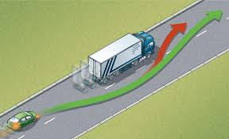
Simulation Process- Part 2 Car Behavior
3.2 overtake and changeline
overtake and changeline condition:
the current velocity is higher than the front car
either side of lanes have spacity

Slide 12
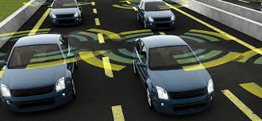
Simulation Process- Part 2 Car Behavior
3.3 check for the front car, traffic light signal, either side car condition
the car must stop when the front is red light signal
the car must check for the other side condition when overtake

Slide 13
Simulation Process- Part 3 Light Behavior
Road matrix: to allocate the road condition
velocity_car matrix: to allocate the the velocity value of cars
gap_car matrix: to allocate the distance to the front car
gap_light matrix: to allocate the distance to the lights

Slide 14
Simulation Process- Part 3 Light Behavior
Simulation output (in terminal):
=============
car simulation
=============
simulation time = 198
4.00 73.00 4.00 91.00 2.00 45.00 gap_car = 4
there is gap car calculation
front light = 20
front light = 20
gap_light = 20
there is gap light calculation
gap_car = 5
there is gap car calculation
front light = 20
front light = 20
gap_light = 16
there is gap light calculation
gap_car = 12
front light = 100
front light = 100
gap_light = 1
there is gap light calculation
velocity_car 2 = 0
velocity_car 2 = 1
velocity_car 2 = 1
velocity_car 2 = 1
velocity_car 2 = 1
velocity_car 2 = 1
velocity_car 2 = 1
v_max = 1
velocity_car 1 = 1
velocity_car 2 = 1
velocity_car 2 = 1
w = 1
restart the car ……..

Slide 15
Simulation Process- Part 4 Traffic Visulization
The movement of the car without the traffic light(num_light = 1(at the end of the road), time_interval = 2)
The movement of the car with the traffic light (num_light = 5, time_interval = 2)

Slide 16
Simulation Process- Part 4 Traffic Visualization
The movement of the car with high traffic light interval (num_light = 5, time_interval = 5)
The movement of the car with high traffic light interval and low restart speed (restart_speed = 1, num_light = 5, time_interval = 5)

Slide 17
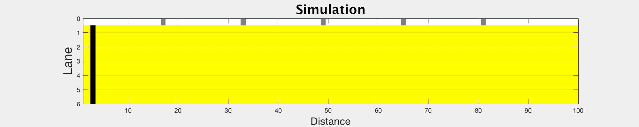
Simulation Process- Part 4 Traffic Visualization
All green light simulation

Slide 18
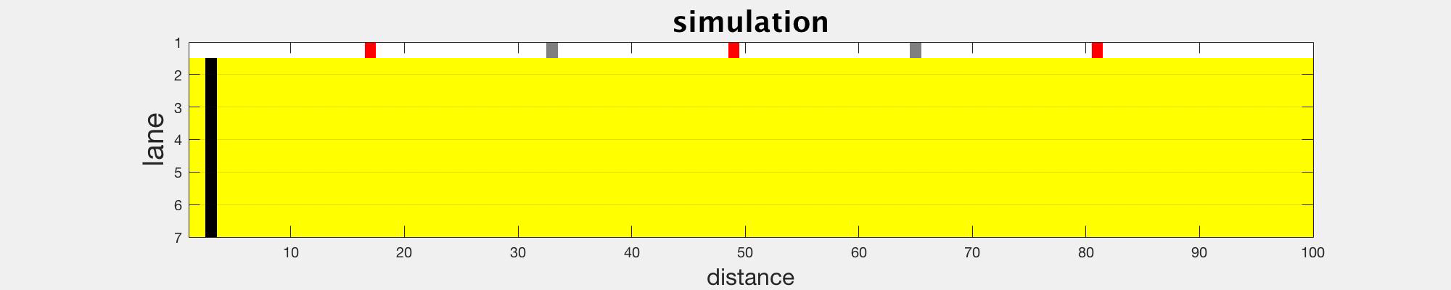
Simulation Process- Part 4 Traffic Visualization
Unsynchronized traffic light situation

Slide 19
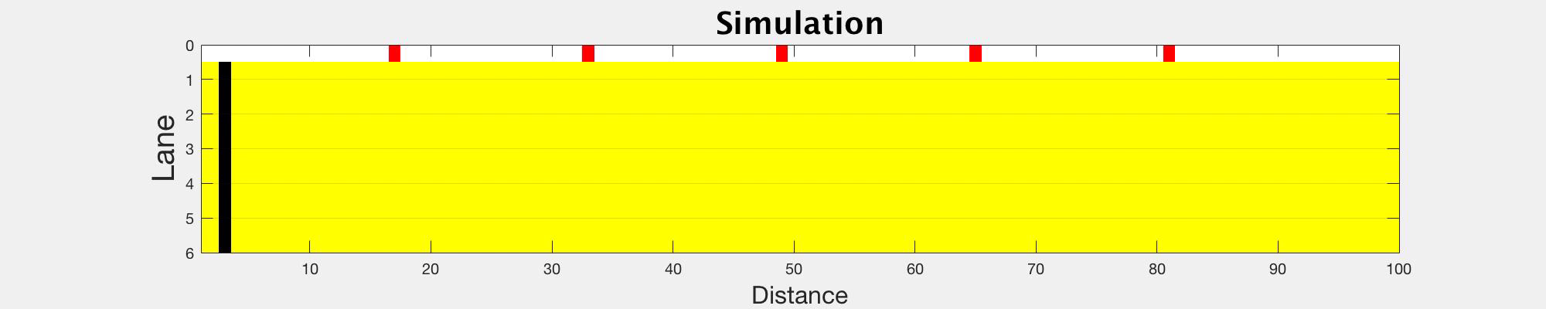
Simulation Process- Part 4 Traffic Visualization
Synchronized traffic light situation

Slide 20
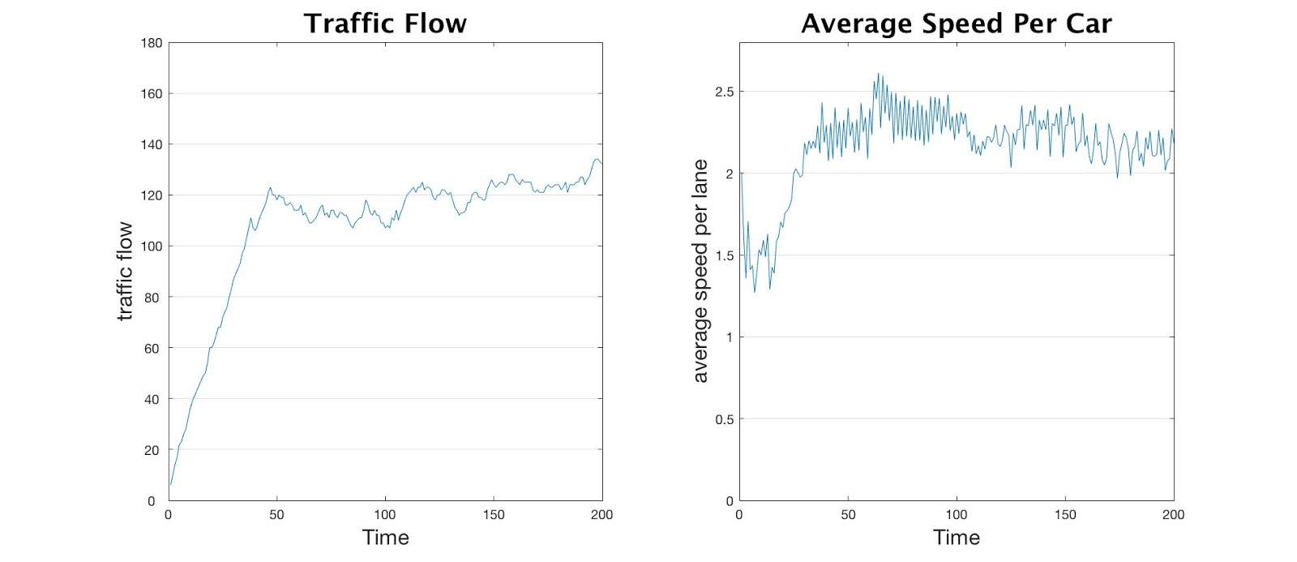
Result Analysis
average traffic flow(from 40secs to the end): 119
the average car speed per time: 2.1603
The sum of the number of moved out of scope cars: 433
It was easy to understand as different car had different speed,
so the distance between one lane cars would get larger as the time went by.
The stagnate in the begin of the road is mainly from the reasons of the gap car.

Slide 21
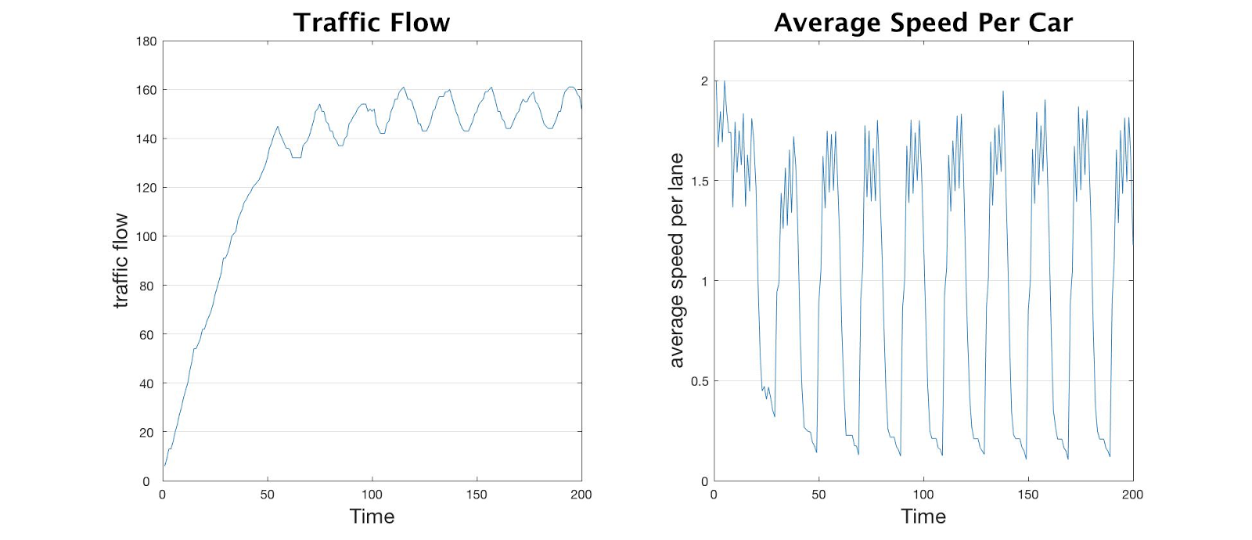
Result Analysis
average traffic flow(from 40secs to the end): 151
the average car speed per time: 1.0434
highest car speed: 2.00
traffic flow : 161
Traffic flow and mean car speed (Synchronized traffic light)
It shows that the traffic flow would first drop down steadily,
because the proportion of the car with speed of zero would increase
and then the average speed would fluctuate around 1

Slide 22
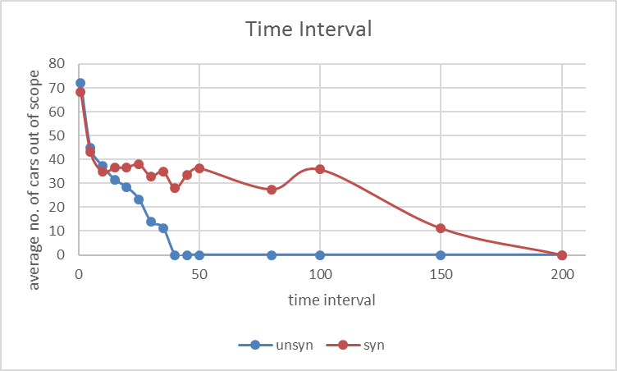
Result Analysis
time interval effect on the average number of cars is significant
many cars would wait for the last green signal when the simulation time is up
time interval effect on asynchronous condition is greater than that of synchronous condition

Slide 23
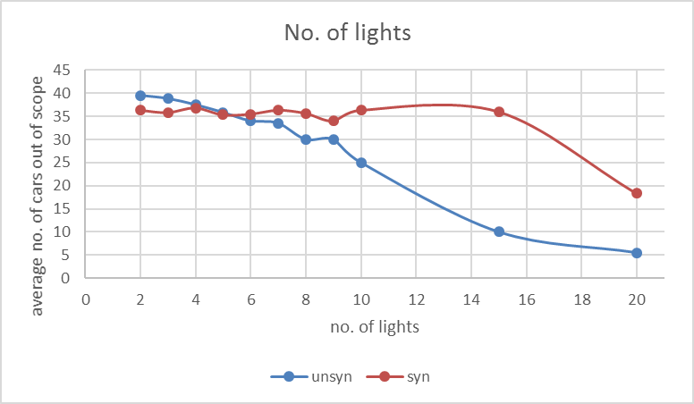
Result Analysis
number of traffic lights
With the increase of the number of traffic lights, the average out car would decrease
number of lights has on the average number of existing cars is significant
more significant under asynchronous condition than that under synchronous condition

Slide 24
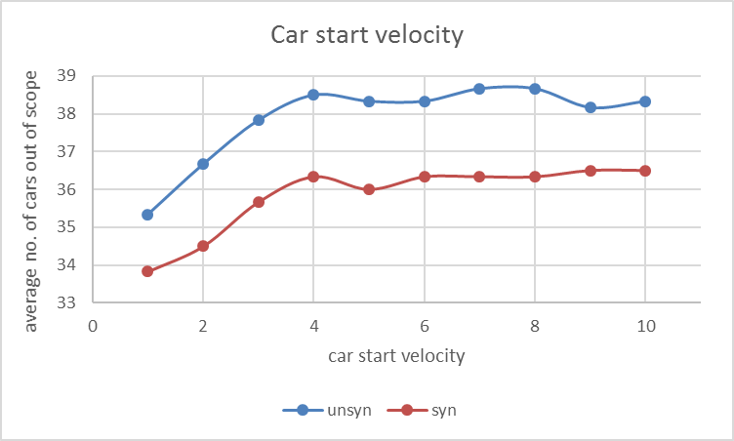
Result Analysis
car start velocity
With the increase of the car start velocity, the average out car would increase
the trend of the two curves is similar
more significant under asynchronous condition than that under synchronous condition

Slide 25
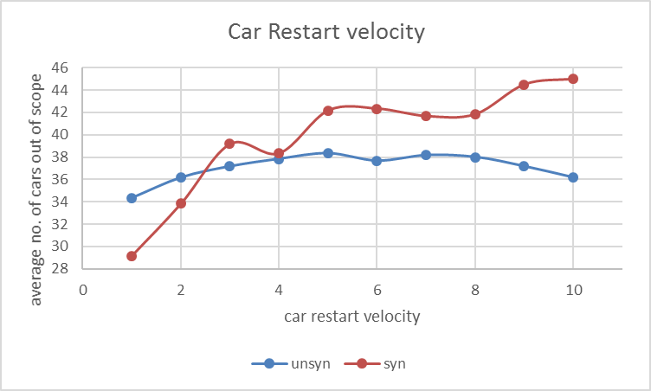
Result Analysis
car restart velocity
with the increase of the car restart velocity,
the number of out car would increase
average amount of exiting cars under
synchronous condition is much larger

Slide 26
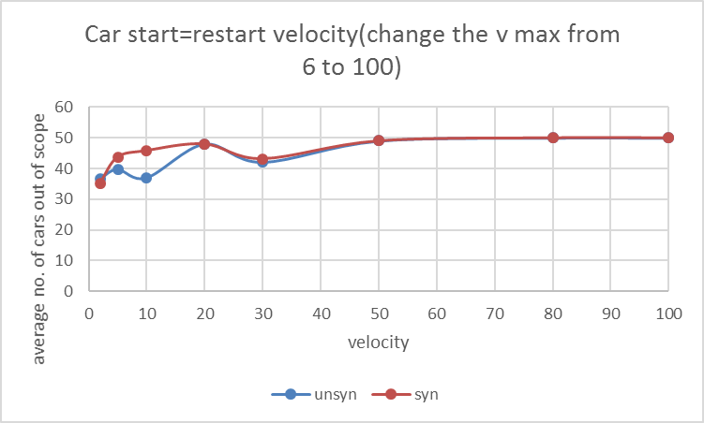
Result Analysis
car restart velocity
keep the restart velocity and the start velocity with same value,
similar graph under synchronized and unsynchronized condition
car restart velocity has a dominant effect on the average amount of out car

